Slide 1
Woodland Public Schools
Facilities and Safety Report
February 2021

Slide 2
FACILITIES REPORT
While clearing snow from the schools, a sinkhole opened under the tractor at WMS. Upon excavating the site, we found an abandoned vault buried down about 12 feet in the old high school location (pre-1950 high school). It was filled and will be paved again soon. The tractor and operator are fine.
We have been struggling a bit to get all of the PPE needed to make it to the end of school. In almost all cases, we now have sufficient PPE to support A/B schedules at WMS and WHS, and full class schedules at all three elementary schools, until the end of the school year.
The Yale well piping froze and broke. The distribution pumps ran dry and damaged one pump. We are operating the system in manual until the pump is returned from the repair facility. We expect the system to be fully repaired by the end of March.
We are revising the procedures for community rentals of the sports fields, taking into account COVID restrictions and procedures. We expect to be able to offer the fields again the week of 22 March.
We purchased an additional two bottle fill stations for installation in the WMS green and yellow hall.
The TEAM High addition final inspection will be 3/23. The TEAM employees will be able to move in after the final inspection is signed off.
We set all of the PPE and room distancing measures in place to get WMS and WHS started back up on the A/B schedule. It’s absolutely fantastic to see all of the kids back in all of the schools again….finally!!
We completed the bi-annual cleanout of all storm drain catch basins.

Slide 3
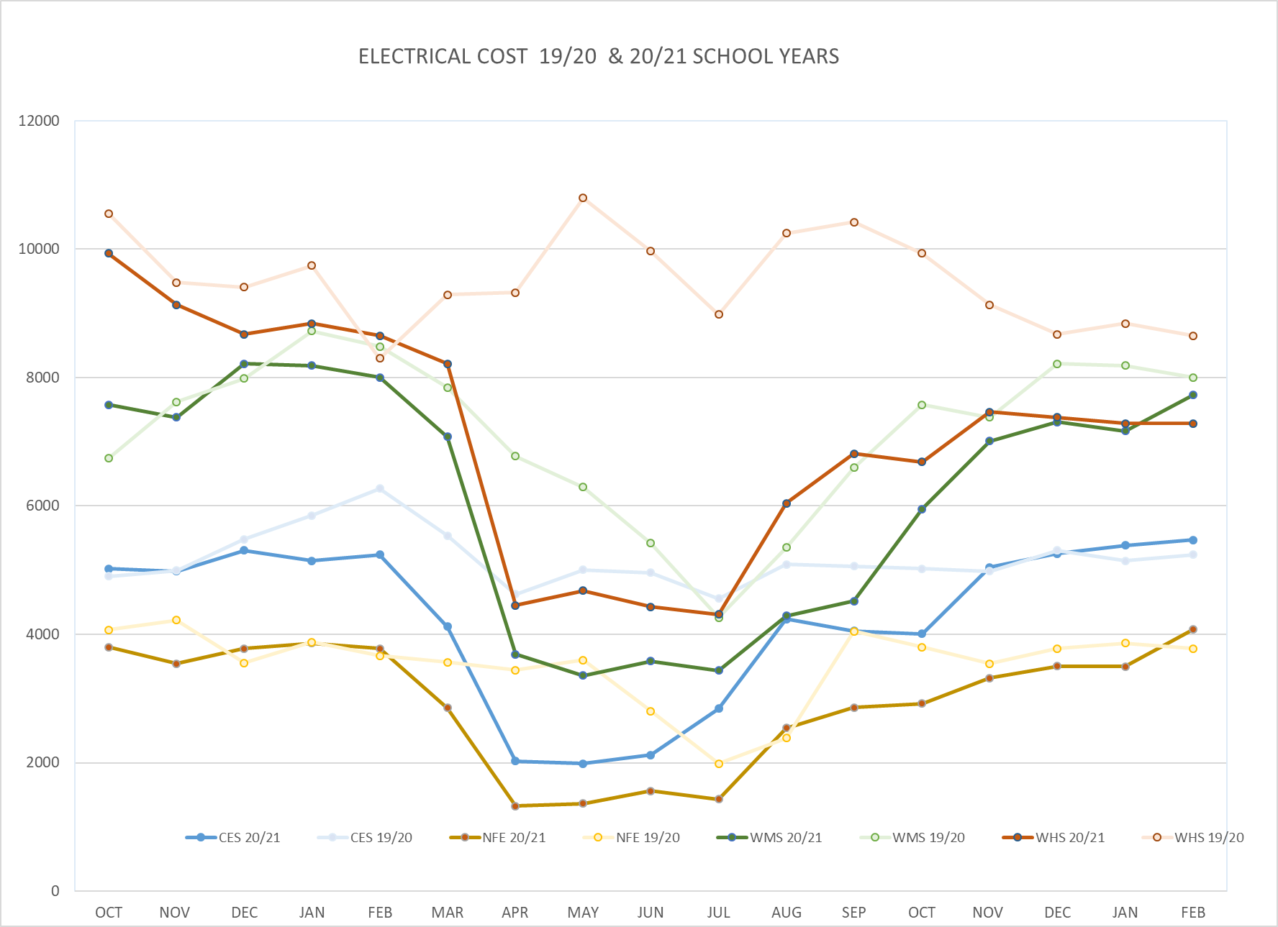
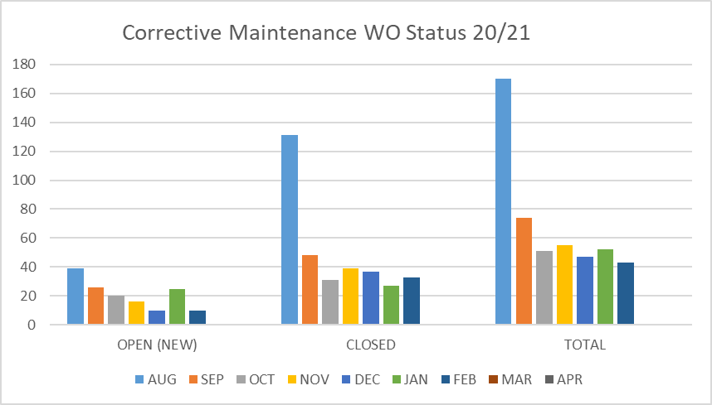
FACILITY CHARTS – POWER COST AND WORK ORDER STATUS

Slide 4
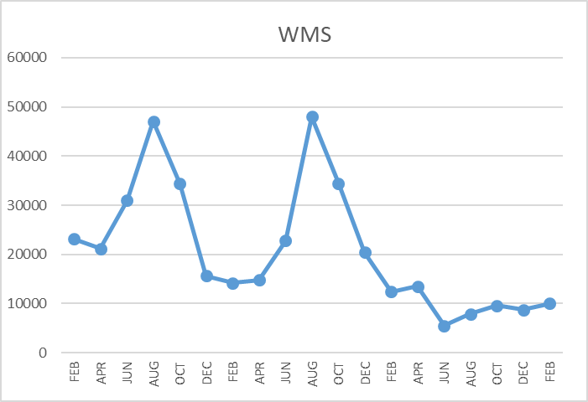
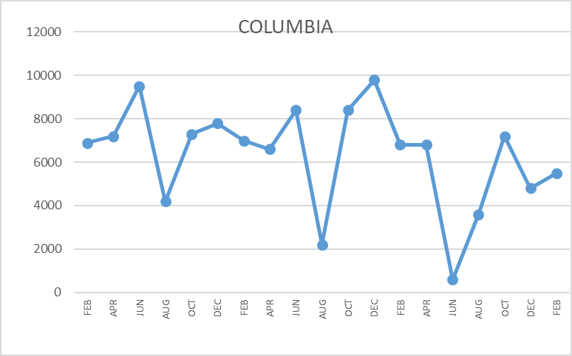
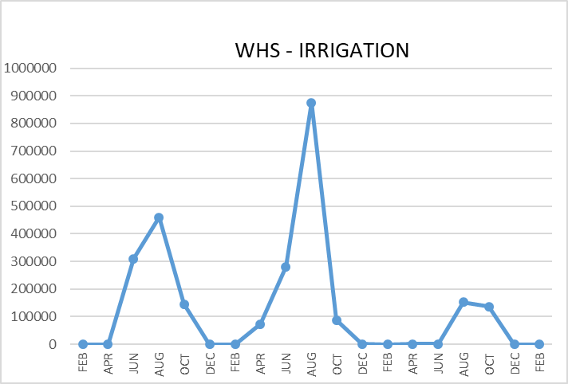
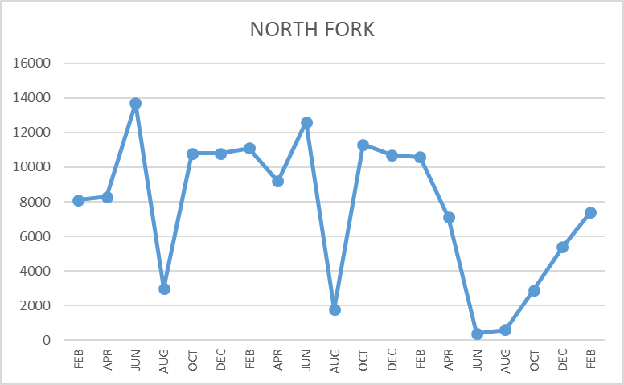
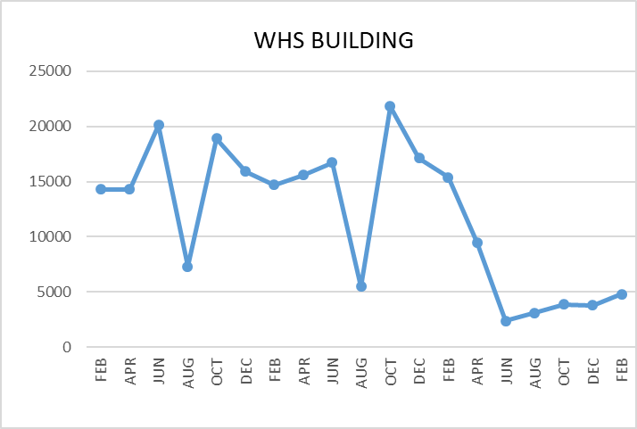
FACILITY CHARTS WATER USAGE WHS, NFES, WMS, CES
Note
Water charts are updated every two
months. Next update to these charts in the May 2021 report.
The WMS chart includes the following 7 meters: 755 Park high and low flow, BO and Team High, PIT house, bus barn, athletic field and DO. All of these meters are totaled on the WMS graph, but each data point is recorded separately to aid in identifying leaks.

Slide 5
Safety Summary
Staff Accidents/Injuries
WMS - Staff member slipped on sidewalk and injured hand and left knee.
KWRL - Driver misjudged distance and fell, getting out of the van and bruised left hand and knee.
Student Accidents/Injuries
NFES – Student tripped on the playground and fractured arm. Review of camera indicated child just tripped, no hazards involved.

